Slide 1


Slide 2




Cross Platform native User Interfaces with Xamarin.Forms
- Udara Alwis

Slide 3







I am Udara Alwis
Xamarin Developer / Enthusiast
Tech Blogger / Speaker
theconfuzedsourcecode
.wordpress.com
github.com/UdaraAlwis
linkedin.com/in/UdaraAlwis
Notes:
My name is Udara Alwis. I’m a Xamarin Developer here in Singapore, and guilty as charged I’m a crazy Xamarin enthusiast.
I’ve got some mad love for Mobile Development and Mobile User Experience Engineering
Of course I’m a Microsoft fan boy. There goes by saying I’m still 24 years old.
When I’m not coding, I go on adventures, running, cycling, skateboarding.. All that fun stuff!

Slide 4
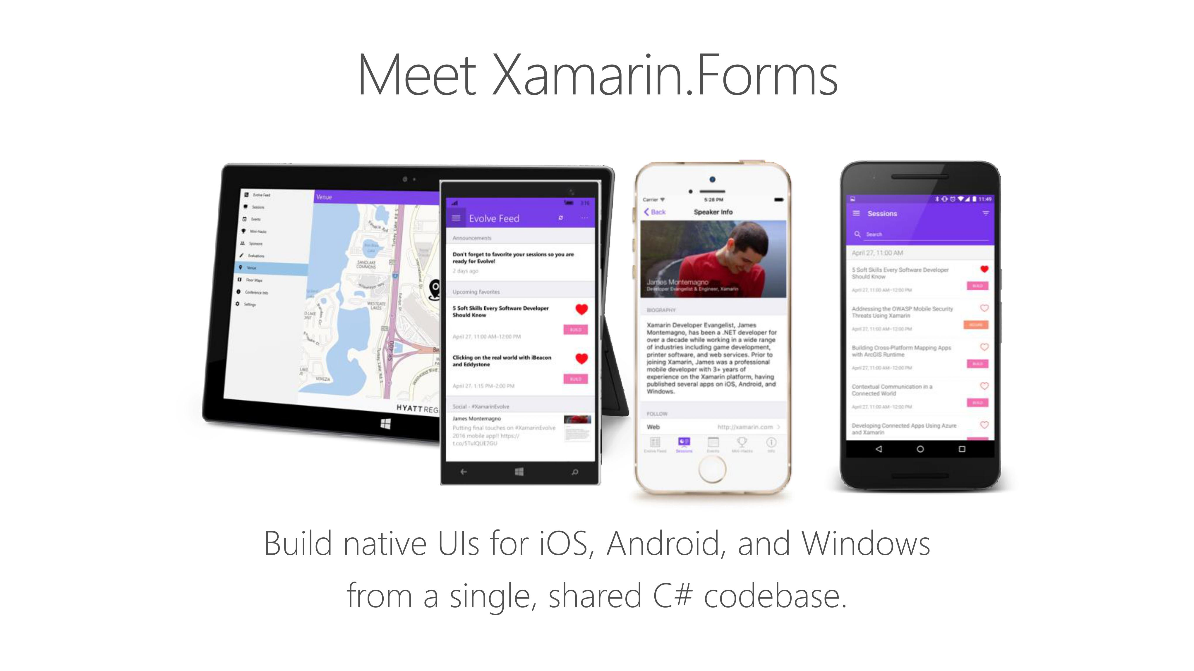

Slide 5
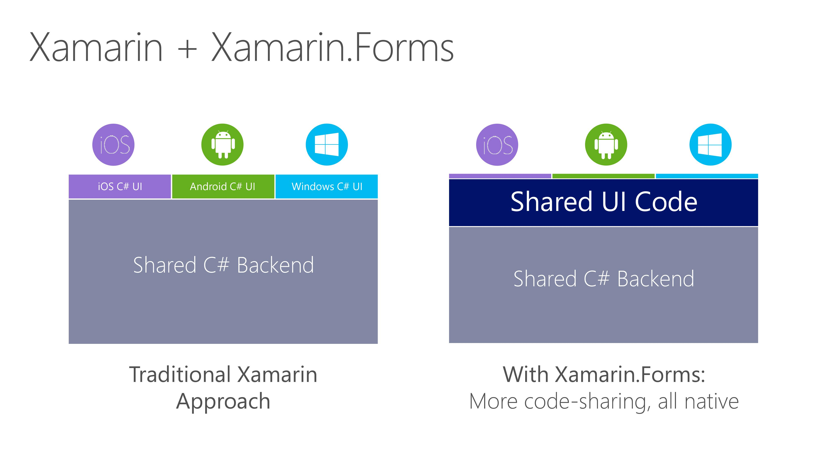

Slide 6
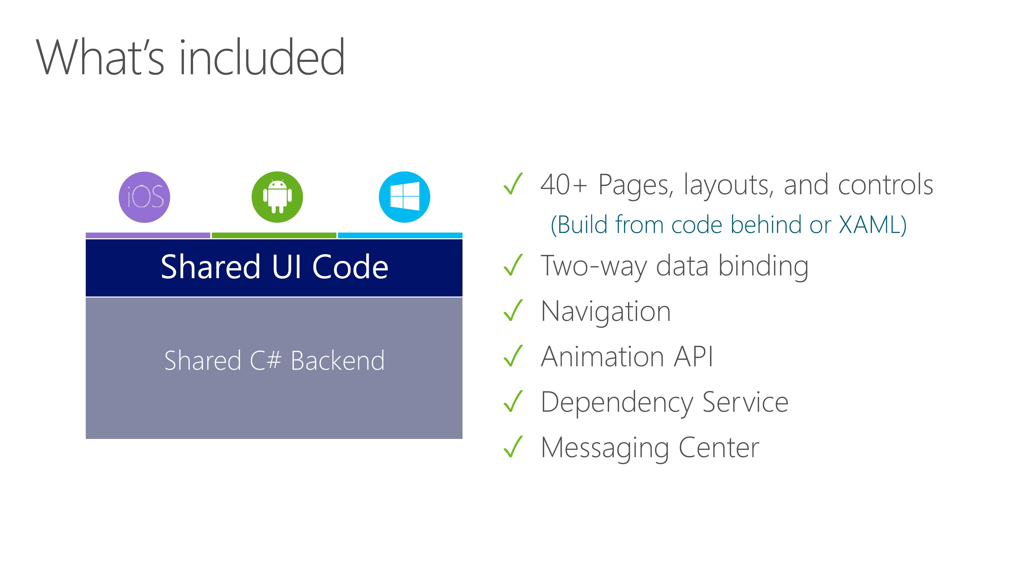

Slide 7
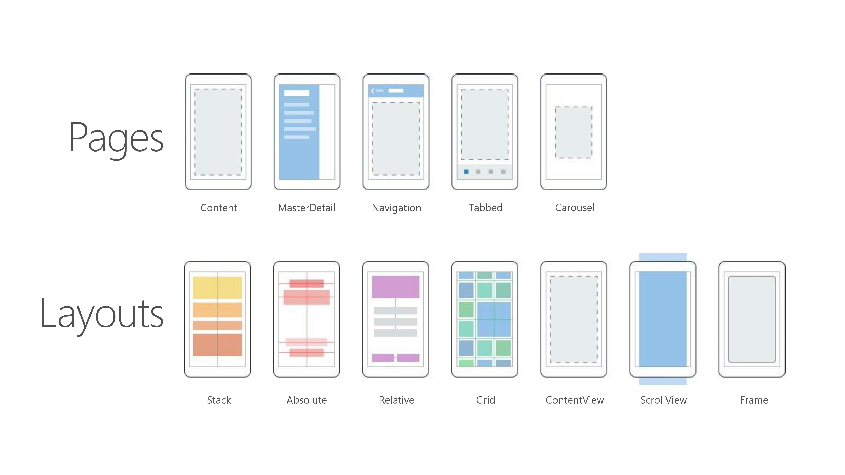

Slide 8
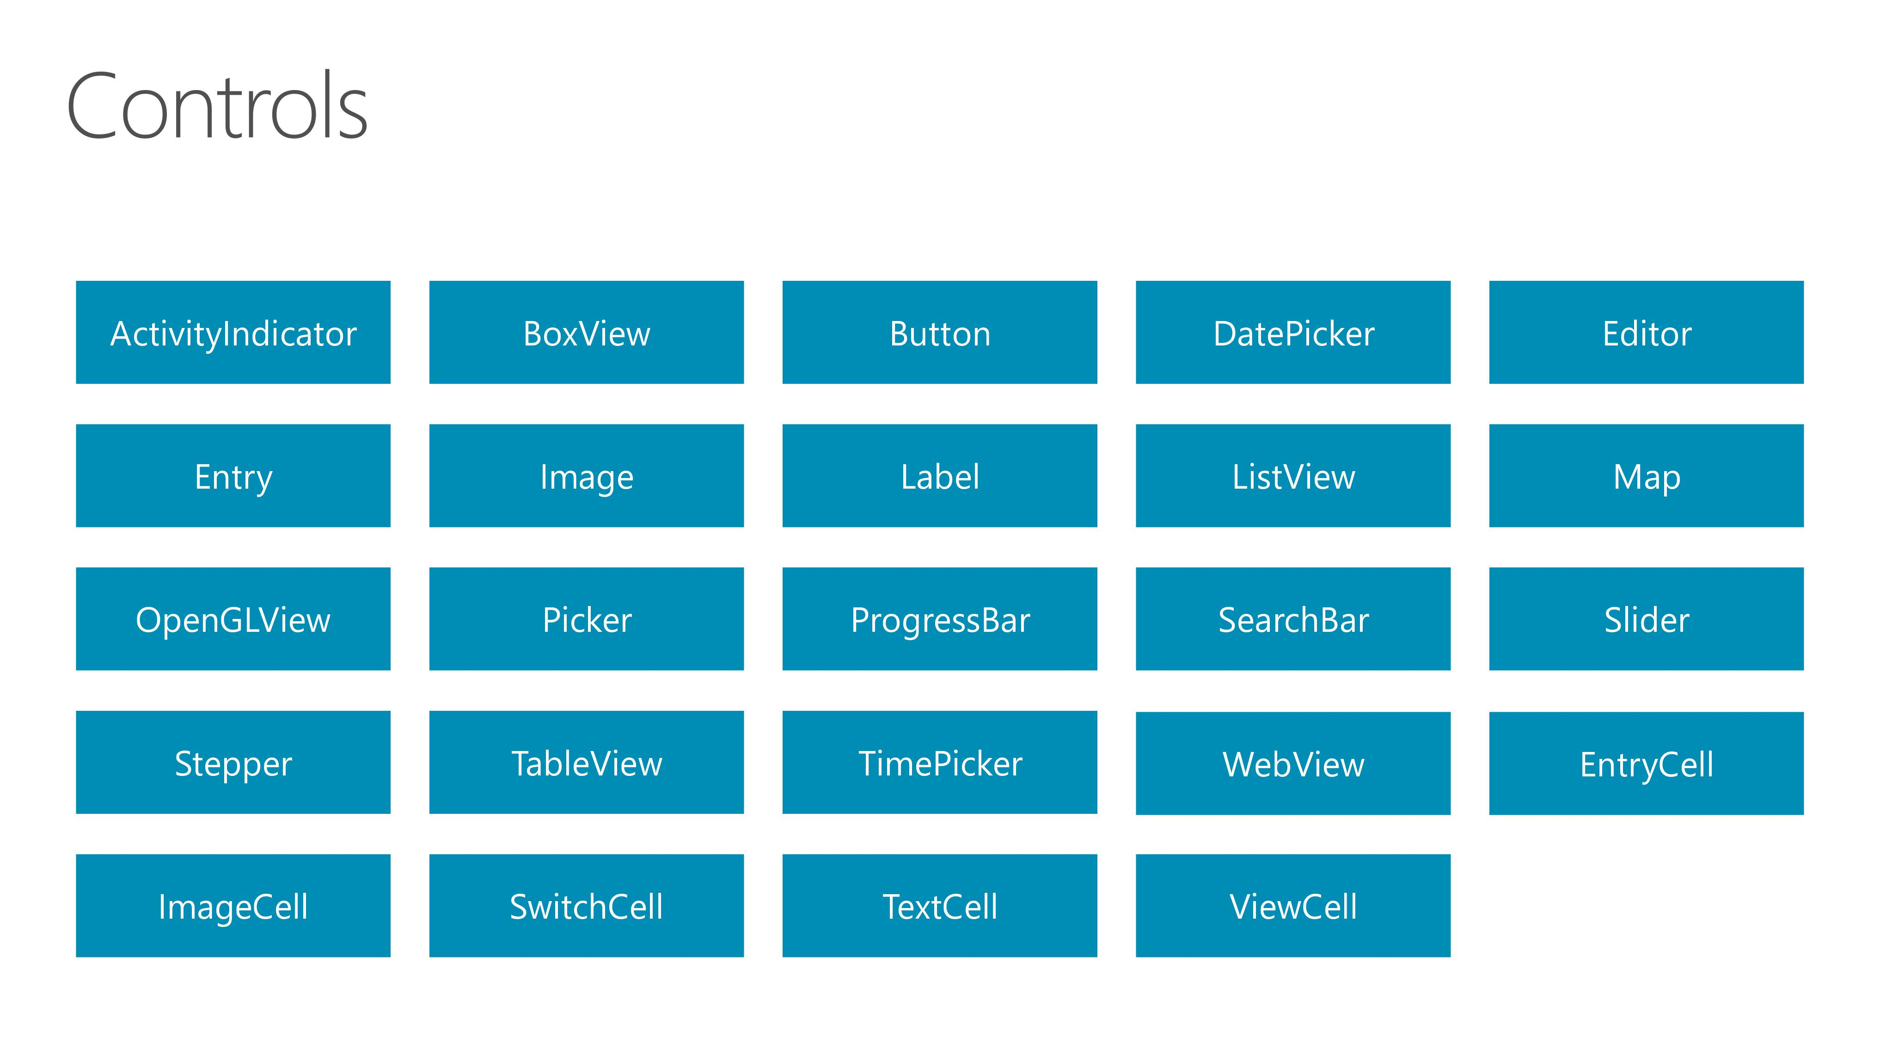

Slide 9


Slide 10
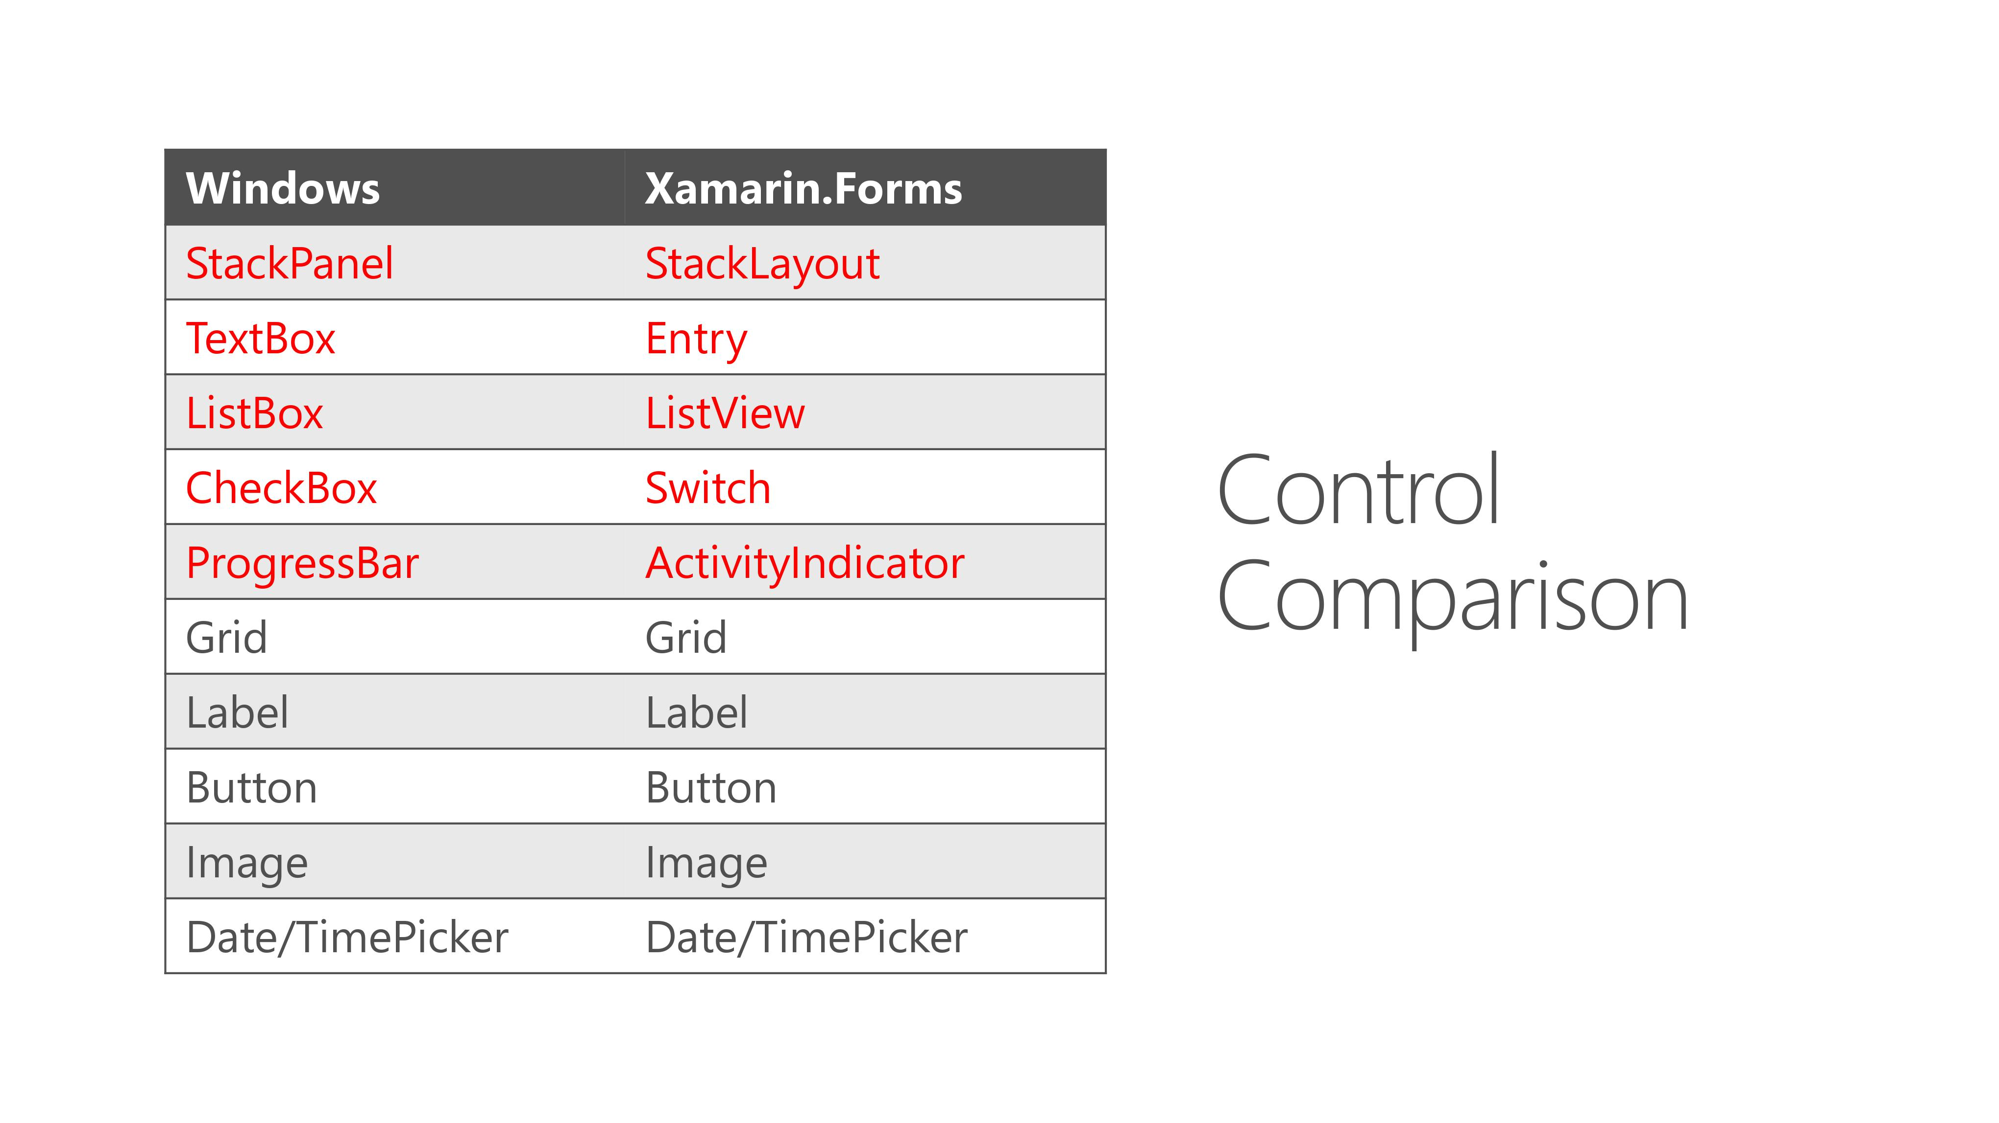

Slide 11
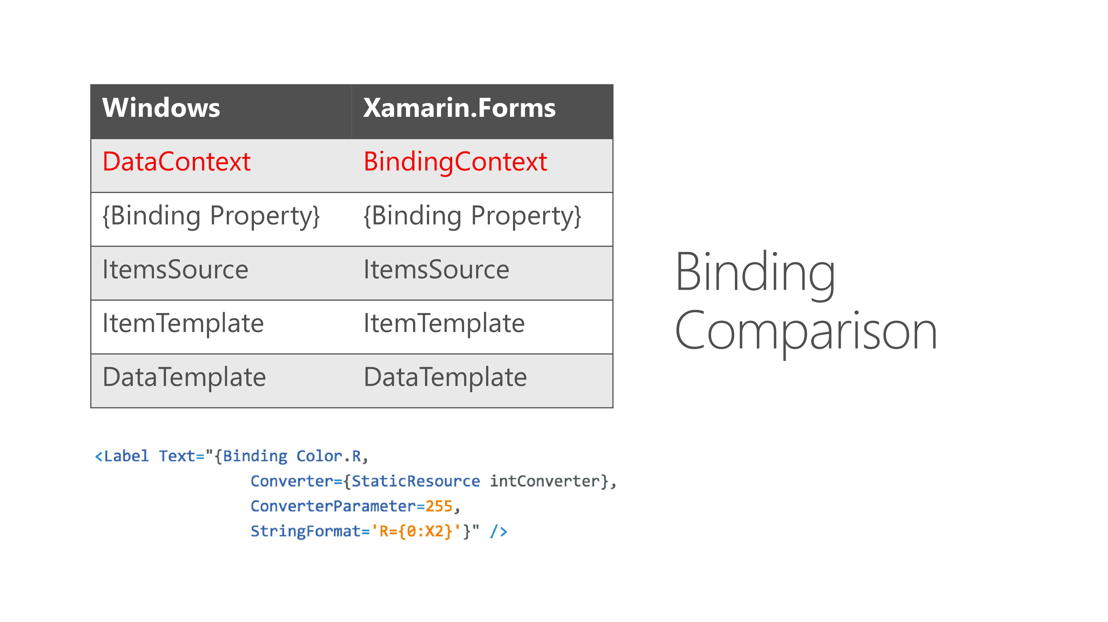

Slide 12
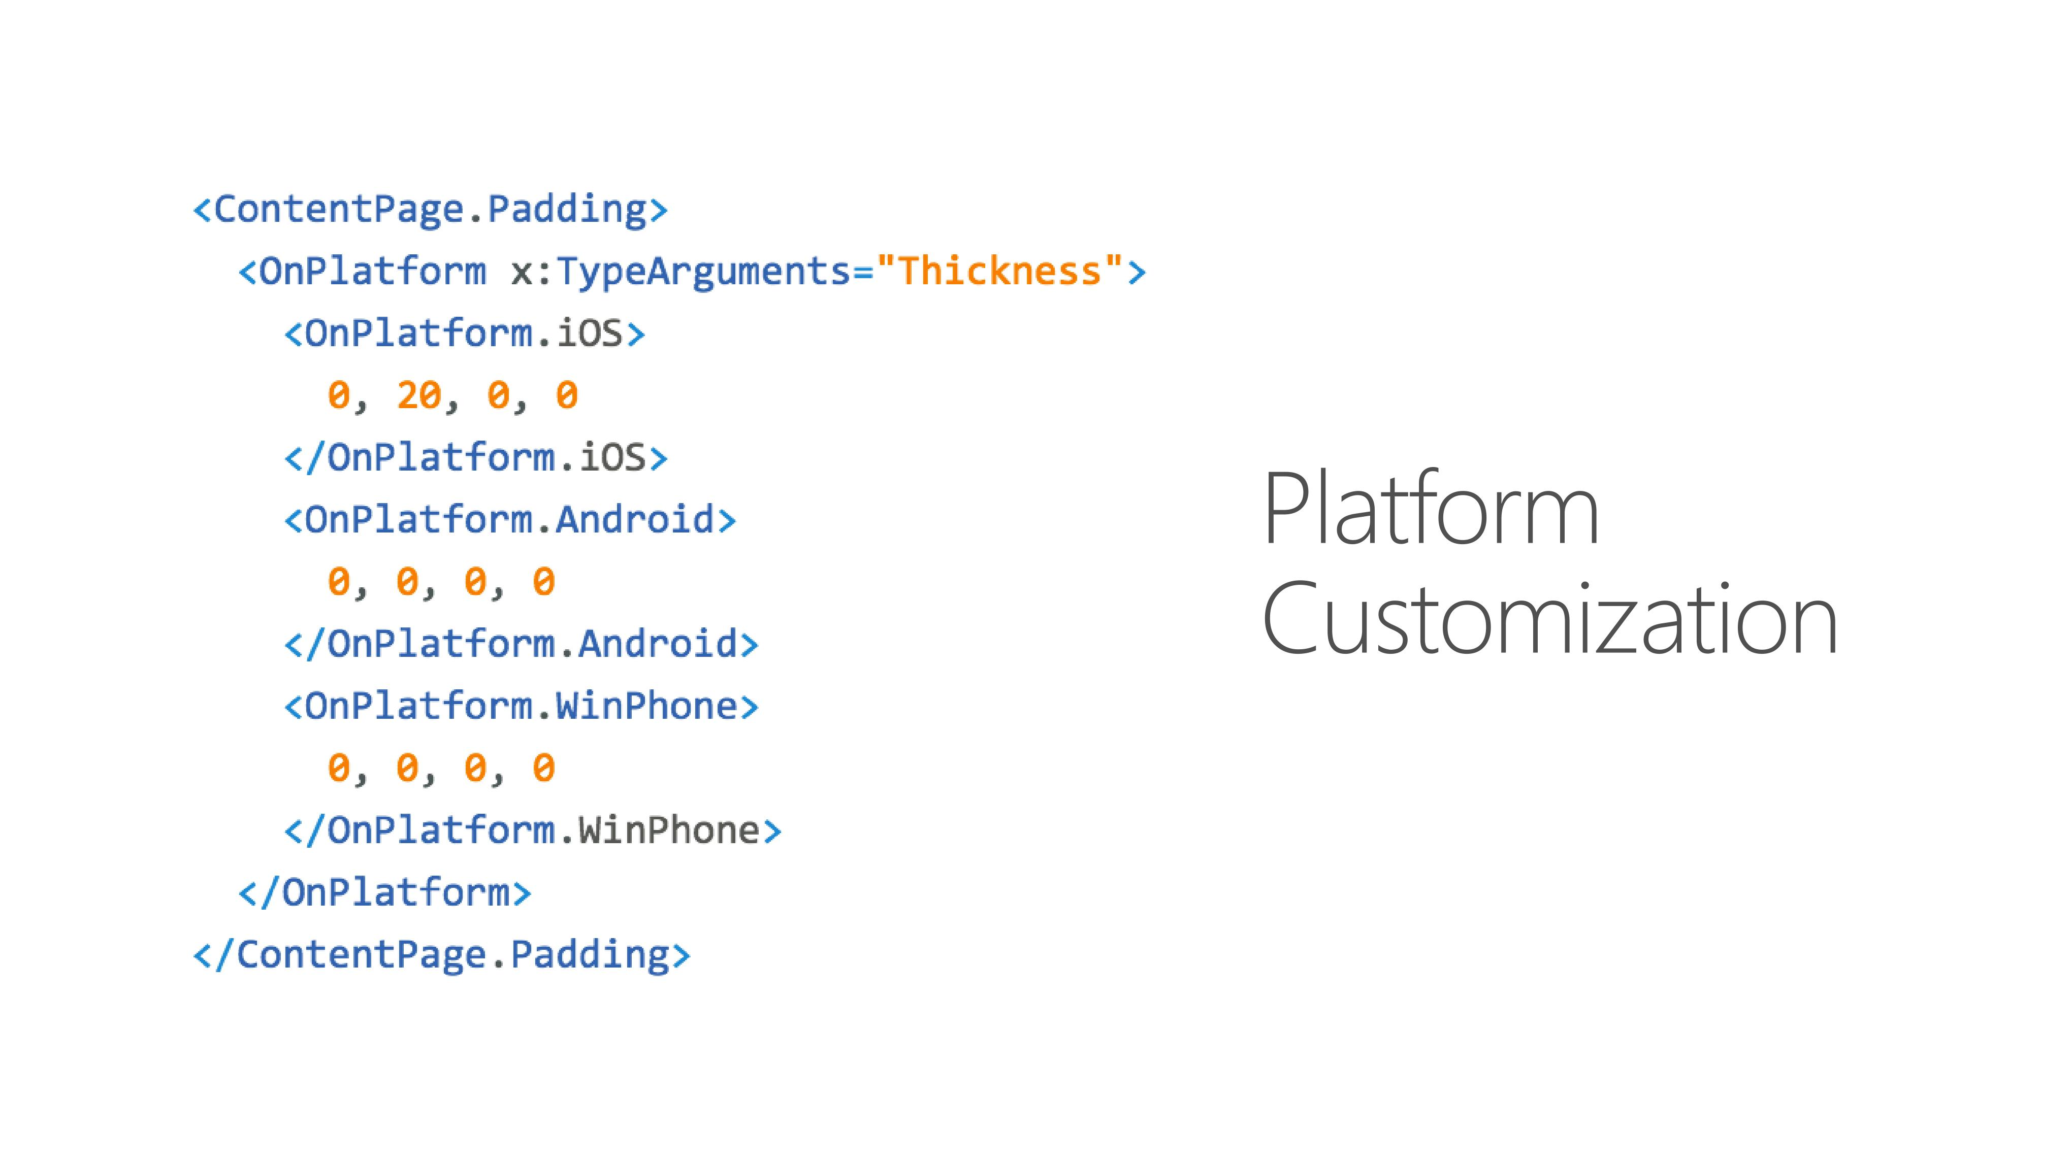

Slide 13
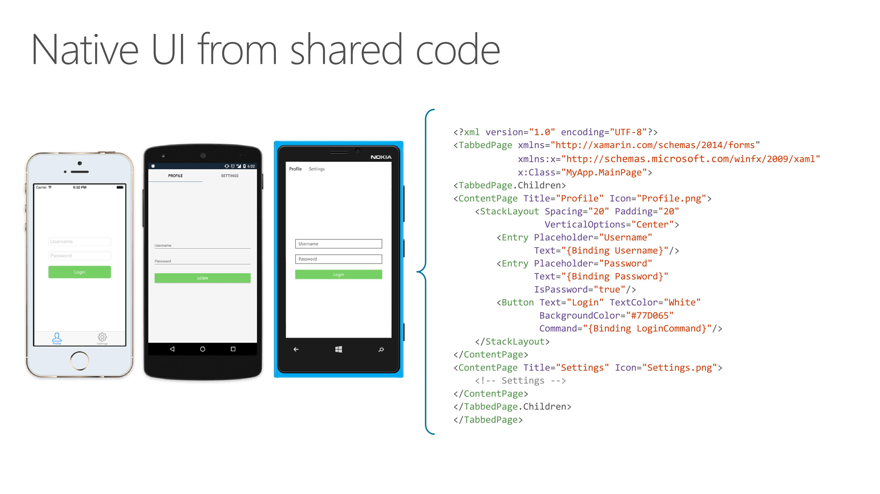

Slide 14


Slide 15

Latest and Greatest in Xamarin.Forms?

Slide 16
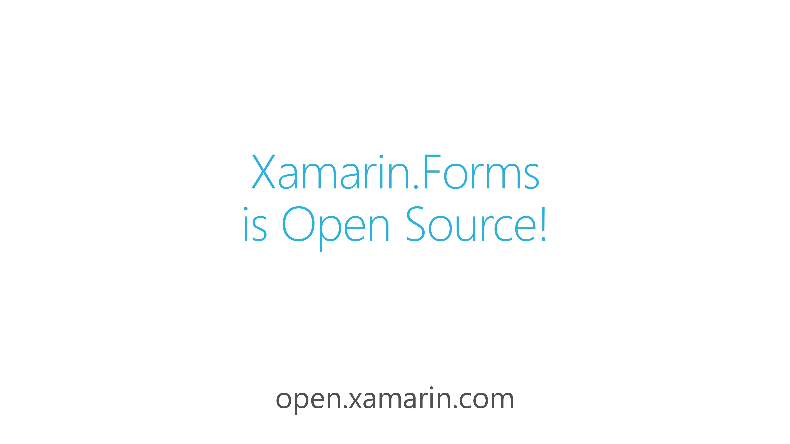

Slide 17
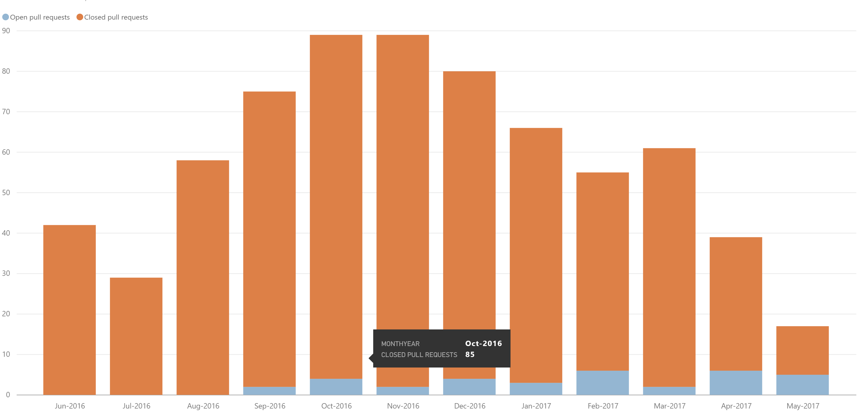
Community
Public Roadmap: aka.ms/xfroadmap
70 contributors
700 merged pull requests
37 evolution proposals

Slide 18
FEATURES

Slide 19
Xamarin.Forms Previewer

Slide 20
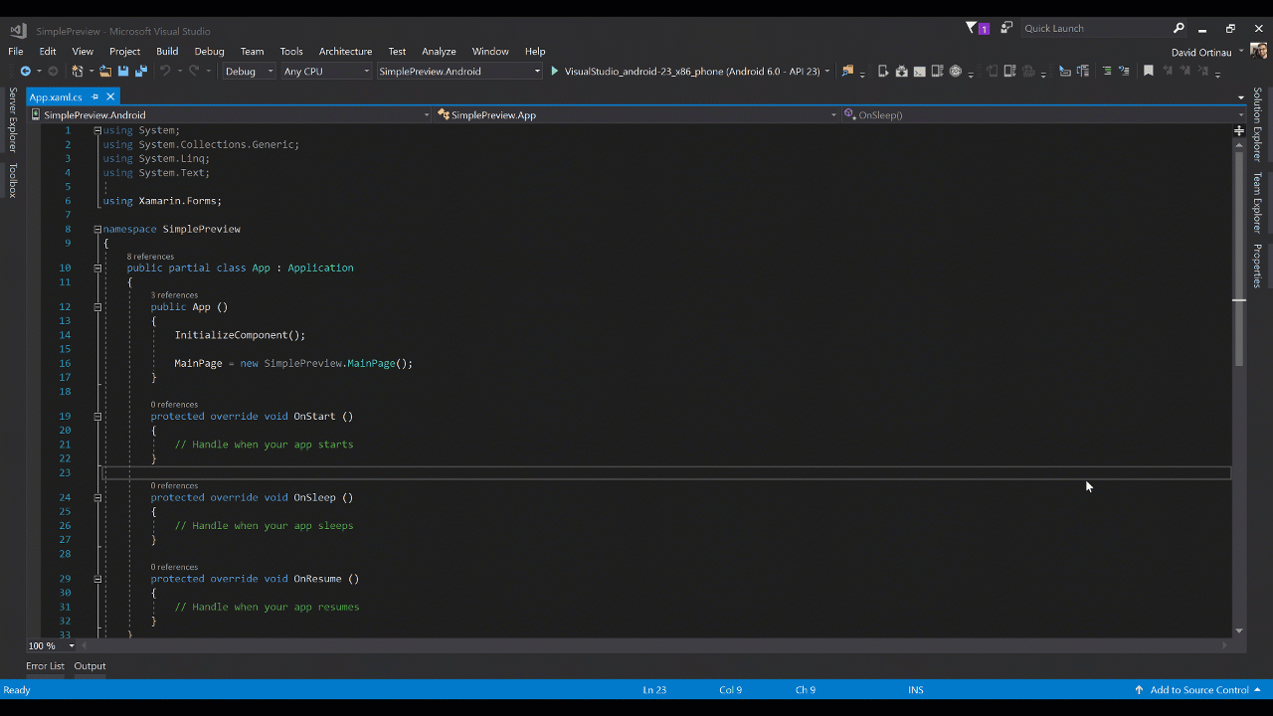
Xamarin.Forms Previewer
Visual Studio for Mac & Windows 2017

Slide 21
Xamarin Live Player

Slide 22
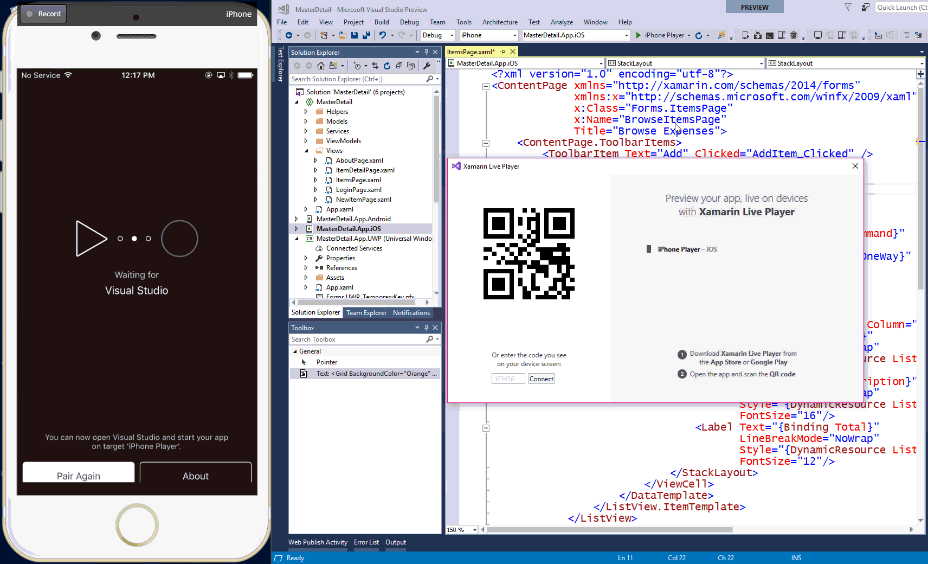
Xamarin Live Player
with Xamarin.Forms
xamarin.com/live

Slide 23
Native View Declarations
Adding Bindable Native Views Directly to XAML

Slide 24
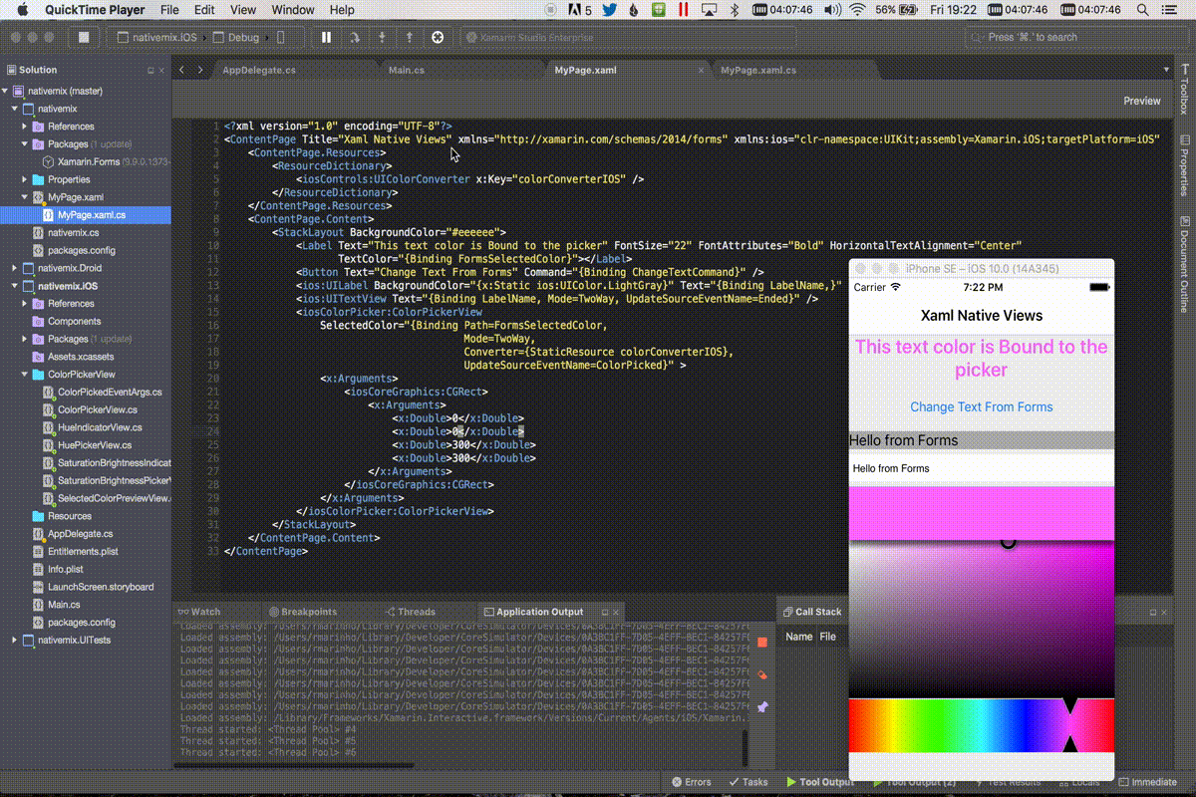

Slide 25
Page Embedding
Embedding Xamarin.Forms in Xamarin Native

Slide 26
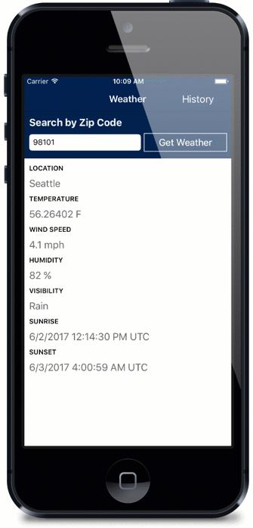
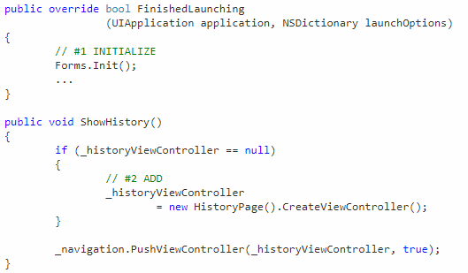

Slide 27
PERFORMANCE

Slide 28
Layout Compression
Remove unnecessary nesting of the Layout Hierarchy

Slide 29
Forms
Grid
StackLayout
ContentView
Button
Grid
Label
Label
WebView
Button
Image
ScrollView
Image
12
Platform
Panel
Panel
Panel
ButtonRenderer
Panel
LabelRenderer
LabelRenderer
WebViewRenderer
ButtonRenderer
ImageRenderer
ScrollViewRenderer
ImageRenderer
TextBlock
Button
WebView
Label
Button
Image
Image
19
Notes:
Source Credit: David Ortinau

Slide 30
Platform+Compression
12
19
Panel
ButtonRenderer
LabelRenderer
LabelRenderer
WebViewRenderer
ButtonRenderer
ImageRenderer
ScrollViewRenderer
ImageRenderer
TextBlock
Button
WebView
Label
Button
Image
Image
16
Notes:
Source Credit: David Ortinau

Slide 31
Fast Renderers
Flattening the Native Control Hierarchy

Slide 32
Forms
Button
Platform
ButtonRenderer
Button
Notes:
Source Credit: David Ortinau

Slide 33
Forms
Grid
StackLayout
ContentView
Button
Grid
Label
Label
WebView
Button
Image
ScrollView
Image
12
Platform+Compression+Fast Renderers
Panel
ButtonRenderer
LabelRenderer
LabelRenderer
WebViewRenderer
ButtonRenderer
ImageRenderer
ScrollViewRenderer
ImageRenderer
WebView
10
Notes:
Source Credit: David Ortinau

Slide 34

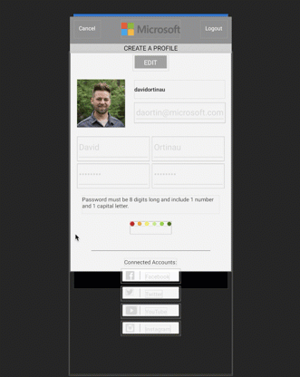
Default:
130 Renderers
Layout Compression + Fast Renderers:
70 Renderers
Notes:
Source: https://blog.xamarin.com/3-big-things-explore-xamarin-forms-2-5-0-pre-release/

Slide 35
New Backends:

Slide 36
New Backends: Tizen

Slide 37
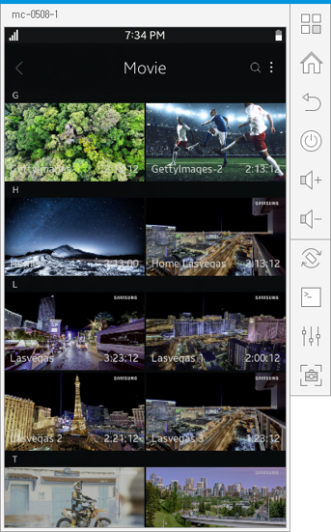
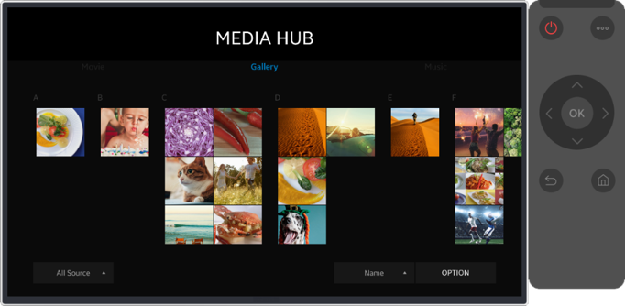

Slide 38
New Backends: WPF

Slide 39
New Backends: GTK#

Slide 40
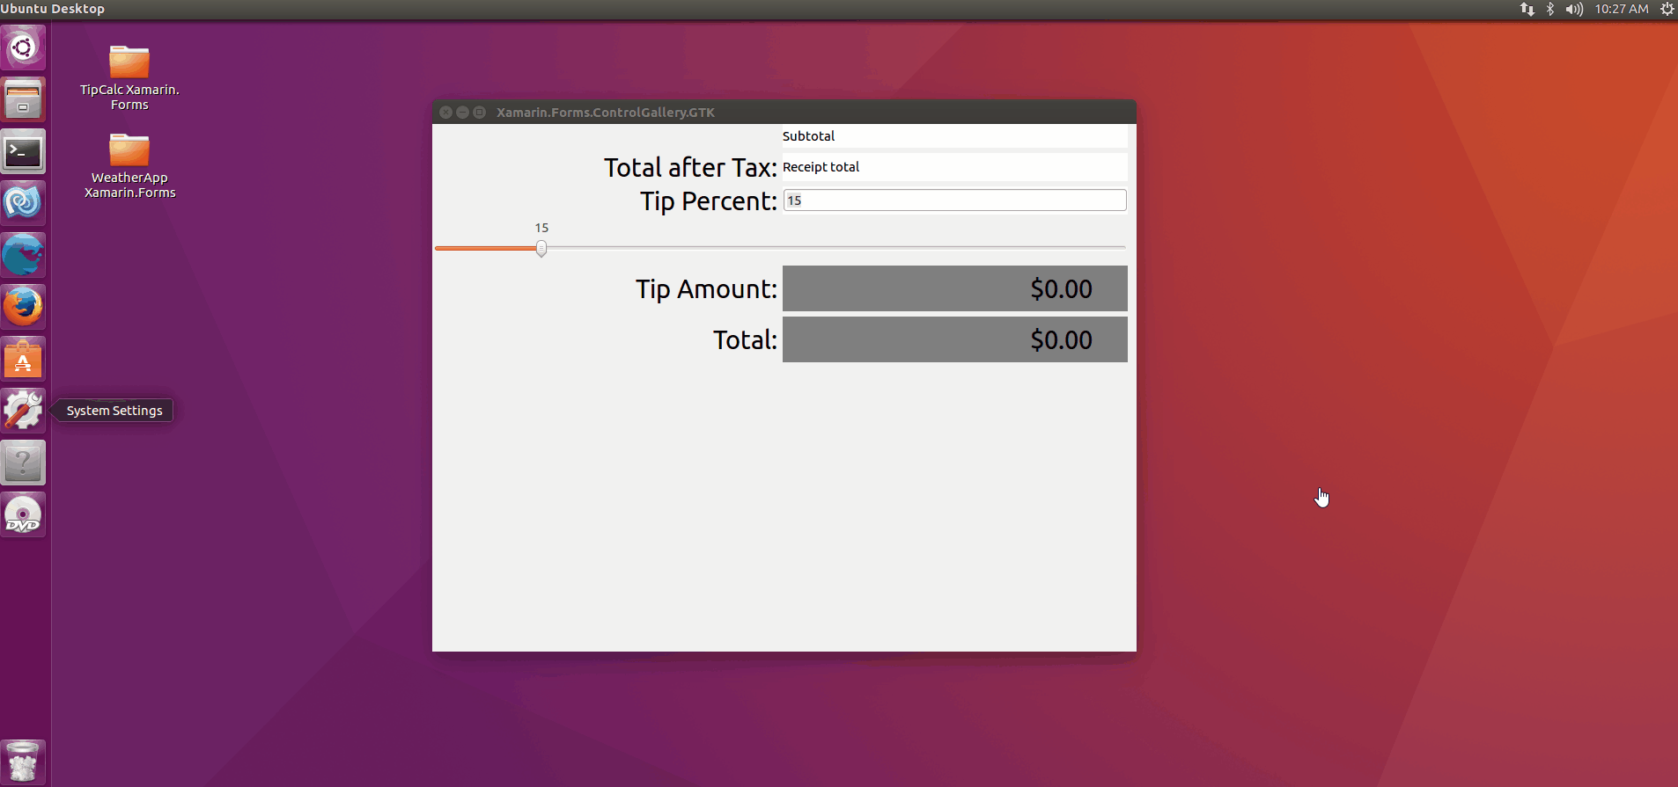

Slide 41
New Backends: macOS

Slide 42
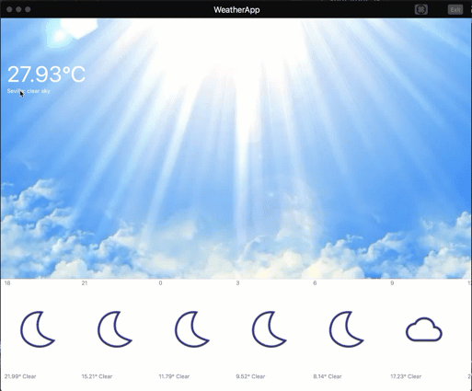

Slide 43
MORE AND MORE…
.NET Standard 2.0
Stability and Performance
Startup Time
160+ bug fixes and enhancements
ListView enhancements, Fast Scroll
XAMLC – 5x faster
Gesture enhancements
New layout: FlexLayout

Slide 44
Thank You!
For Weekly Xamarin Articles check out my blog, https://theconfuzedsourcecode.wordpress.com
Udara Alwis
CODENAME: [ÇøŋfuzëÐ SøurcëÇødë]

